Slide 1

ICDD: Information Container for linked Document Delivery
ISO standard for describing, relating & packaging documents | Dr. ir. H.M. Böhms

Slide 2
ICDD overview
Home: ISO TC 59/SC 13/WG 8
Organization and digitization of information about buildings and civil engineering works, including building information modelling (BIM)
Two parts
ISO 21597-1:2020 Information container for linked document delivery — Exchange specification — Part 1: Container
ISO 21597-1:2020 Information container for linked document delivery — Exchange specification — Part 2: Link types
Status
Part 1: International Standard (IS), https://www.iso.org/standard/74389.html
Part 2: Final Draft International Standard (FDIS), International Standard in late 2020 (Nov/Dec)

Slide 3
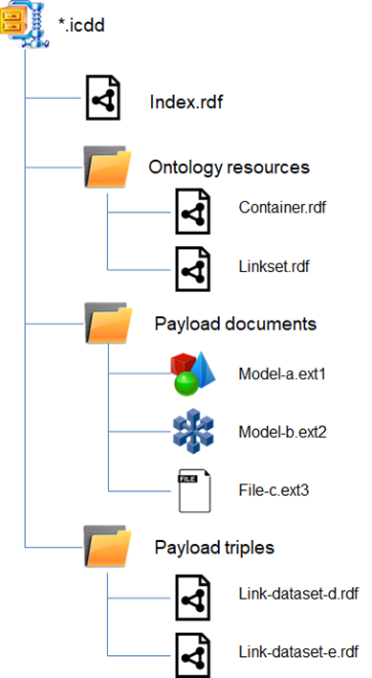
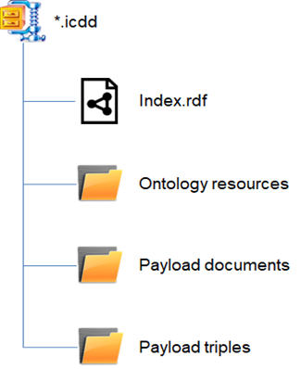
Container .ICDD zip
Note: payload doc can be anything
(including an ontology or RDF data set)

Slide 4
three key meta ontologies
Name spaces
https://standards.iso.org/iso/21597/-1/ed-1/en/Container (Part1)
https://standards.iso.org/iso/21597/-1/ed-1/en/Linkset (Part 1)
https://standards.iso.org/iso/21597/-2/ed-1/en/ExtendedLinkset (Part 2)
Prefixes
ct
ls
els
Primary language: OWL, primary serialisation: RDF/XML
Documents can be internal or external
Links can be deep links to element IN document via a general “identifier” mechanism

Slide 5
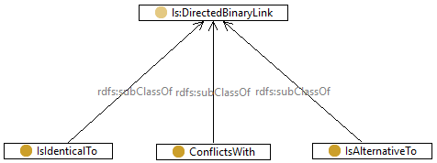
Part 2 semantic relation /1
Meaning: functional/inverse-functional

Slide 6
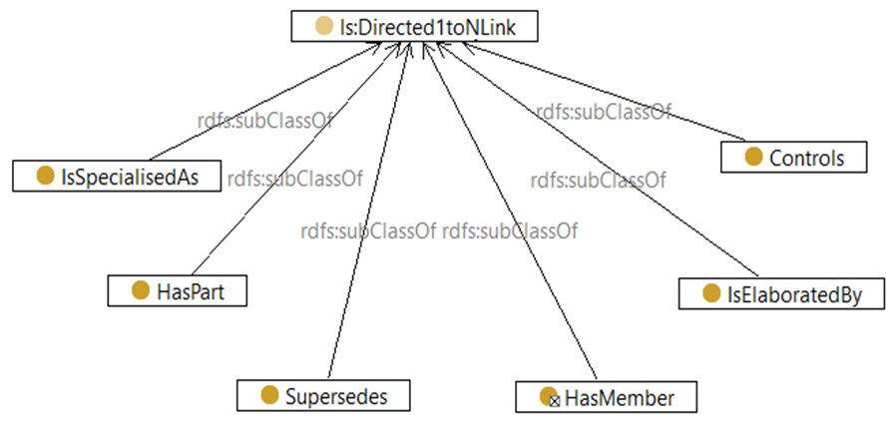
Part 2 semantic relation /2

Slide 7
Index.ttl example file fragment
<ct:containsDocument>
<ct:InternalDocument rdf:ID="id39a2f462-8685-4258-8e33-8e1441bc1c3f">
<ct:description>Excel template for the timesheet</ct:description>
<ct:versionID>1</ct:versionID>
<ct:name>TimeSheetTemplate.xlsx</ct:name>
<ct:versionDescription>first version</ct:versionDescription>
<ct:requested rdf:datatype="http://www.w3.org/2001/XMLSchema#boolean">false</ct:requested>
<ct:filename>TimeSheetTemplate.xlsx</ct:filename>
<ct:filetype>xlsx</ct:filetype>
<ct:creationDate rdf:datatype="http://www.w3.org/2001/XMLSchema#dateTime"
>2018-05-28T14:13:28.167</ct:creationDate>
<ct:format>application/vnd.openxmlformats-officedocument.spreadsheetml.sheet</ct:format>
<ct:createdBy rdf:resource="#id0b80ea4e-eba1-481f-bc97-309c0de355b9"/>
</ct:InternalDocument>
</ct:containsDocument>

Slide 8
links.ttl example file fragment acc. to Part 2
<els:IsElaboratedBy rdf:ID="l1a5178ee-a1e1-4b0e-8a28-54b6b3fa2423">
<ct:versionDescription>first version</ct:versionDescription>
<ls:hasFromLinkElement>
<ls:LinkElement rdf:ID="le9c55ddfa-5c98-4f5d-908c-248dfc7bd03c">
<ls:hasIdentifier>....... </ls:hasIdentifier>
<ct:versionDescription>first version</ct:versionDescription>
<ct:createdBy rdf:resource="https://standards.iso.org/iso/21597/-2/ed-1/en/AnnexA/usecase/delivery/Index#idad118169-
4c6a-4afe-9c2a-5d21e6f2a602"/>
<ct:creationDate rdf:datatype="http://www.w3.org/2001/XMLSchema#dateTime"
>2018-05-28T14:13:28.167</ct:creationDate>
<ct:versionID>1</ct:versionID>
<ls:hasDocument rdf:resource="https://standards.iso.org/iso/21597/-2/ed-
1/en/AnnexA/usecase/delivery/Index#idd9292d86-a0ed-4dd4-8e5b-ae1437bf40c0"/>
</ls:LinkElement>

Slide 9
Known issues
Scope is data exchange, not data sharing like with a Common Data Environment (CDE)
See LDAC paper RWTH (Madhu, Jyrki, Jakob)
Objectified Relations are unhandy
Complex, indirect
No reuse of standard OWL functionality for properties (symmetry, functional, transitivity, inverse)
Language is OWL but interpretation is “closed world”, formally not ok
Primary format is RDF/XML, not Turtle (but allowed, finally …)
Terminology is misleading: “binary link” means a “functional & inverse functional” (1:1) link
Some inconsistencies like: Why not Index.rdf also in payload triples folder?

Slide 10
Paper Common Data Environments for ICDD
Madhumitha Senthilvel, Jyrki Oraskari, and Jakob Beetz
Design Computation, Faculty of Architecture, RWTH Aachen University, Aachen, Germany
“However, ICDD is a file-based container system, which means that it has the
same limitations of file sharing. Without extra measures, the availability of the
data for every partner and the possibility to access the most up-to-date data
may not be insured. Common Data Environment (CDE) [11] addresses these
issues, providing a single platform digital access to the containers and their relevant
documents.”

Slide 11
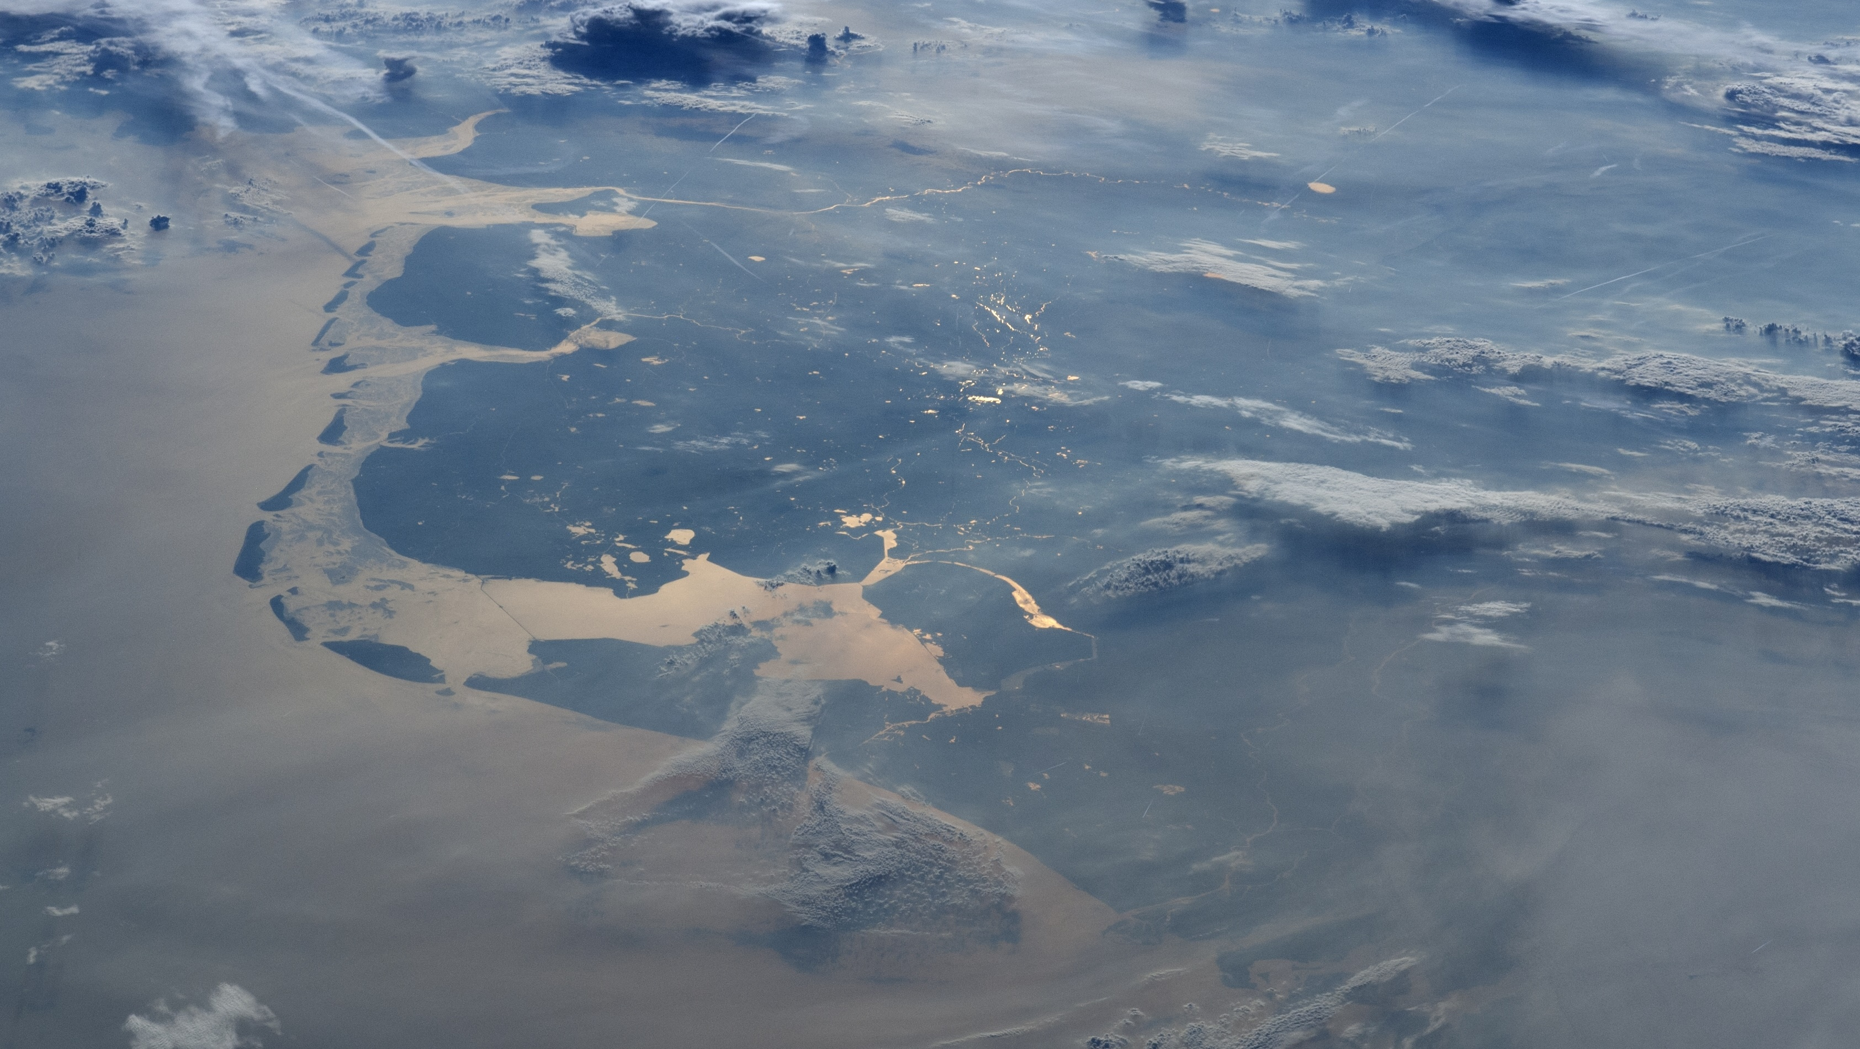
Thank you for
Your time

